Slide 1
Digital twin for wind energy industry
Adrien Hirvoas, Ph.D. - FEM
ISEN Yncréa Ouest

Slide 2
Digital twin for wind energy industry
Day 1: Welcome and Introduction Why wind energy ? Digital Twin Overview Practical work - Python: TP – Python introduction TP – Pandas introduction TP – Anomaly detection introduction | Day 2: Introduction Overview of OpenFAST Practical work: Inputs and outputs workflow Running OpenFAST OpenFAST Modules OpenFAST tool: python-toolbox Practical work: Practicing Run your first simulation | Day 3: OpenFAST reminder OpenFAST tutorial Practical work: Post-Processing A digital twin approach Anomaly detection Conclusion & Question

Slide 3
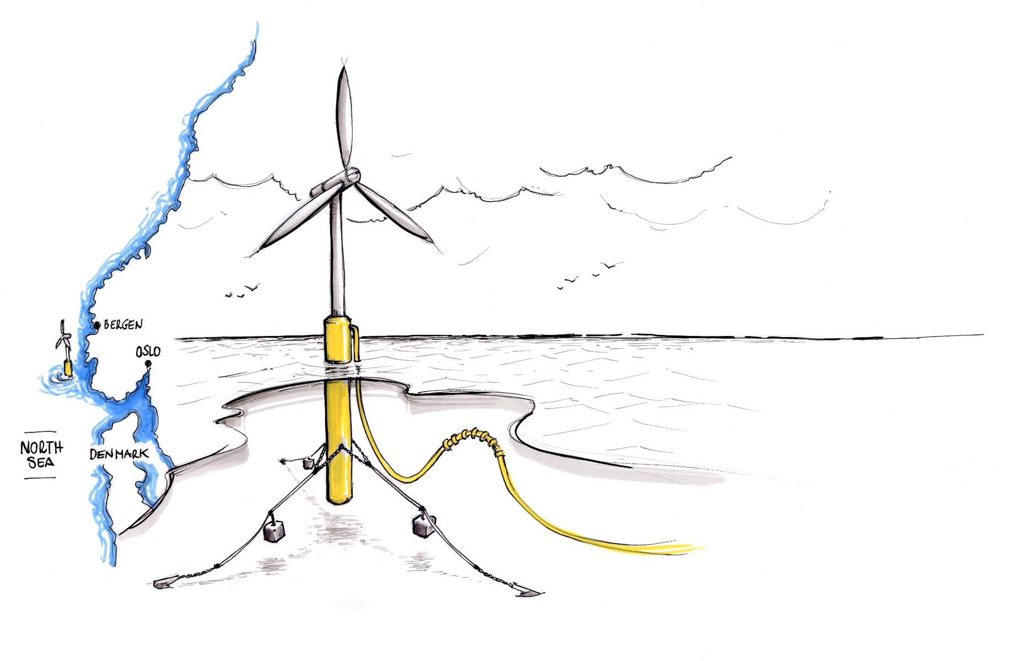
Day 2 - Agenda
Introduction
Overview of OpenFAST
OpenFAST modules
Practice – Offshore wind turbine

Slide 4
Introduction – Numerical modelling
Why?
Lower wind cost of energy requires technology advancement through improved engineering capability founded on physics.
What?
Improved physics-based engineering design competence and software needed to advance wind energy technology.
How?
Use the knowledge, data, and results from broader wind research to improve physics-based engineering design competence and software.
Physic-Based
Knowledge
Real-World
Data
Engineering Design Competence and Models
Advanced Wind
Energy
Technology at
Lower Cost

Slide 5
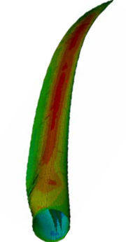
Introduction – Numerical Modelling
Coupling Between Fluids, Structures, and Controls
Controls
Aerodynamics
Hydrodynamics
Structures

Slide 6
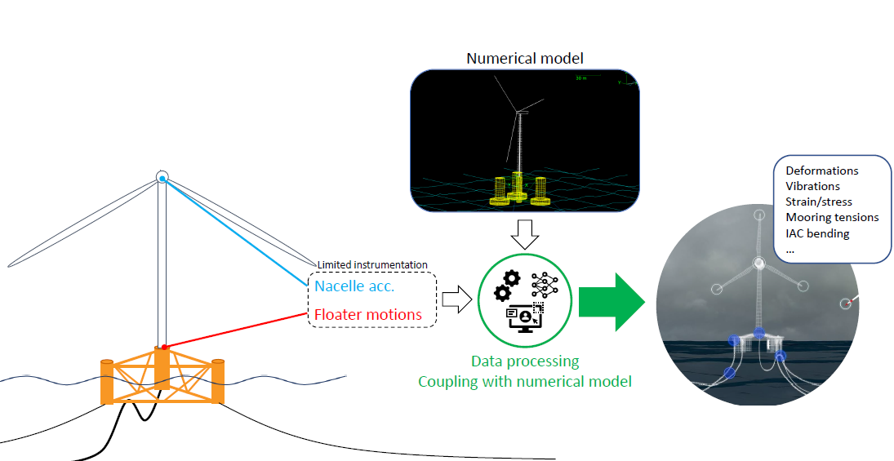
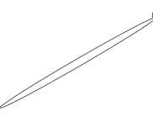
Introduction – Digital Twin Goal
Digital Twin - Wind Turbine
What for ?
Improve availability
Reduce operational expenditure (OPEX)
Streamline inspection
Anticipate life extension
Improve future designs

Slide 7
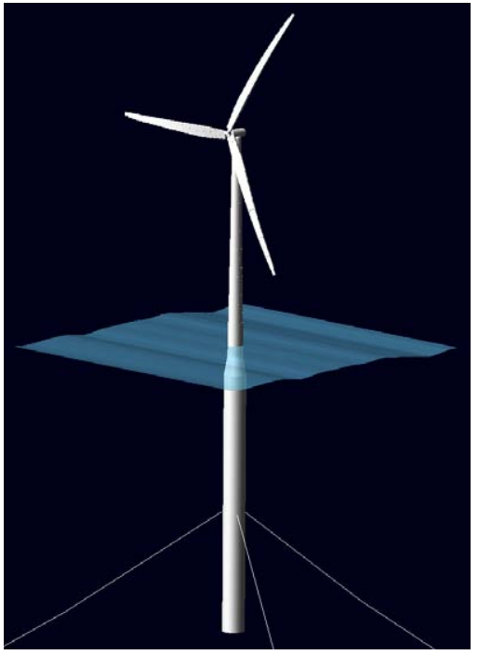







Introduction – Digital Twin Benefits
 | Full sensor monitoring | Numerical monitoring | DT monitoring
Installation & maintenance costs
Accuracy
Reliability

Slide 8
Day 2 - Agenda
Introduction
Overview of OpenFAST
OpenFAST modules
Practice – Onshore wind turbine

Slide 9
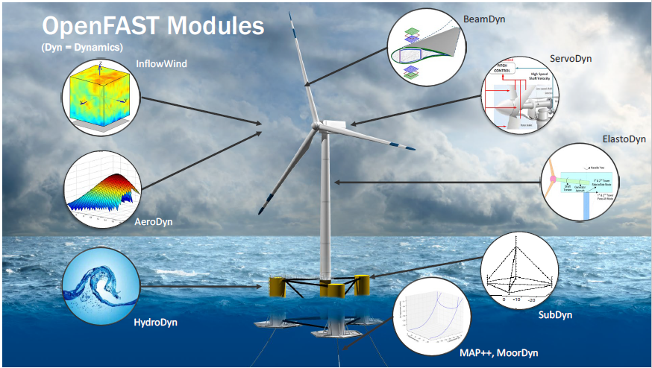
Overview of OpenFAST
OpenFAST: An Open-Source Tool for Wind Turbine Physics-Based Engineering Modeling
An open-source wind turbine physics-based engineering tool
Mathematical models are implemented in distinct modules & interconnected to solve for the global, coupled, dynamic response of a system
Currently an open-source code-development community for physics-based engineering models

Slide 10
Overview of OpenFAST
OpenFAST - inputs and outputs
INPUTS:
one main file (extension .fst) which references other files
OUTPUTS:
one data file (.out or .outb) with time series of selected output channels
optional files: summary (.sum), echo (.ech), linearization (.lin), visualization (vtk)
Main.fst
ElastoDyn.dat
Main.out
ED_Tower.dat
Time (s) | Rotor Speed (rpm) | … | Channel[n] (unit)
0 | 5.0
0.1 | 4.9
… | …
tMax | 5.5
ED_Blade.dat
OpenFAST executable
AeroDyn.dat
AD_Blade.dat
Polar.dat
….
Main*.sum
Main*.ech
Main*.lin
vtk*/
…

Slide 11
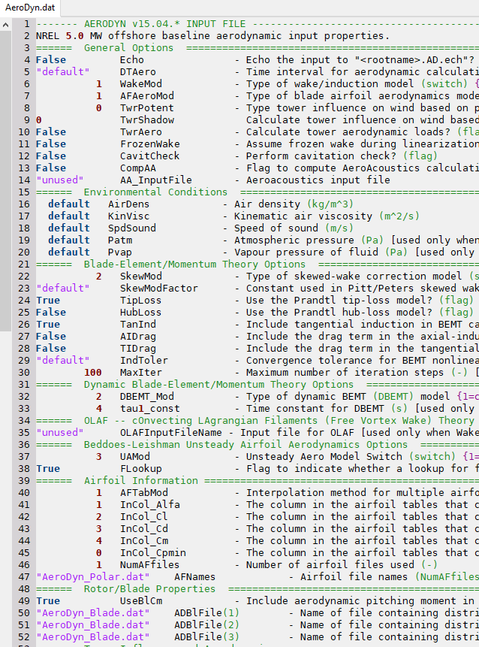
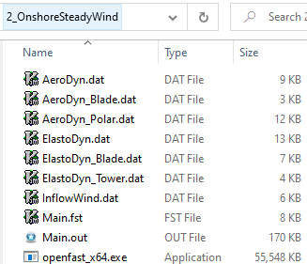
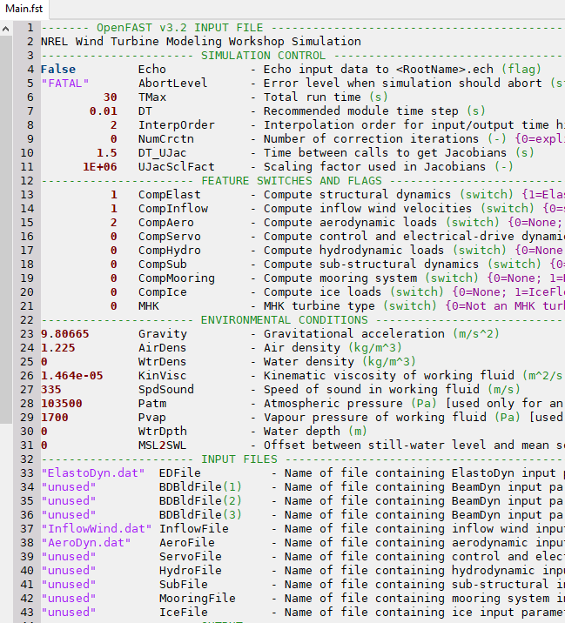
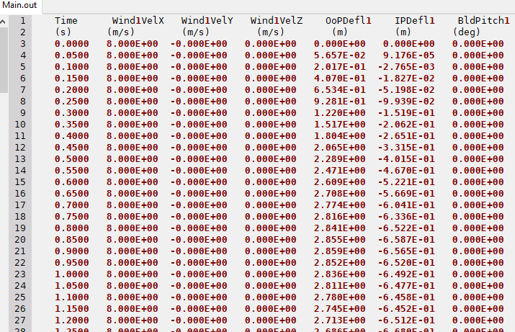
Overview of OpenFAST
OpenFAST - inputs and outputs (in practice)
Typical folder:
INPUTS
OUTPUT
EXE

Slide 12
Day 2 - Agenda
Introduction
Overview of OpenFAST
OpenFAST modules
Practice – Offshore wind turbine

Slide 13


OpenFAST modules
Additional ElastoDyn input files (.dat)
Additional AeroDyn input files (.dat)
Wind data files (.wnd, .bts, hh, etc…)
Bladed-style external controller (.dll)
Additional HydroDyn input files (.dat)
Primary (.dat)
ElastoDyn | Structural dynamics
Primary (.dat)
AeroDyn | Aerodynamics
Primary (.dat)
InflowWind |
Wind Inflow
Primary (.dat)
ServoDyn |Control and Electrical Drive Dynamics
Primary (.dat)
HydroDyn |Hydrodynamics
Primary (.dat)
MAP++ |Quasi static Mooring Dynamics
OpenFAST driver
Primary (.fst)
Linearization (.lin)
Visualization (.vtp)
Times Series (.out, .outb)

Slide 14
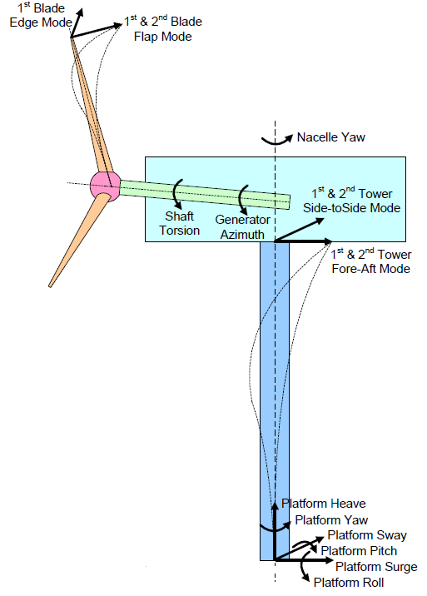
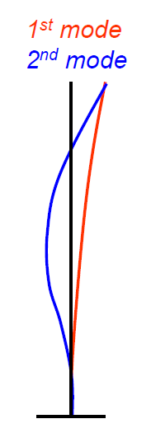
OpenFAST modules
ElastoDyn
Computes structural response as part of the aero-hydro-servo-elastic solution
Combined modal & multi-body representation through 24 Degrees of Freedom
Multi-body: platform, nacelle, generator, gears, hub, tail
Modal: blades, tower
Blade & tower modeling assumptions:
Bernoulli-Euler beams
Straight & isotropic
Bending only
Small to moderate deflections
Modal
representation

Slide 15
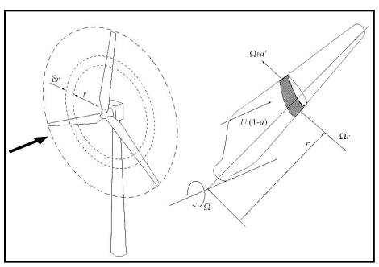
OpenFAST modules
AeroDyn
Computes aerodynamics (lift, drag, pitch) as part of the aero-elastic solution
Wind-inflow input:
Uniform, unsteady
Turbulent (TurbSim)
Wake modeling:
Blade Element Momentum (BEM) theory
Dynamic wake (DBEMT)
Dynamic stall modeling:
Beddoes-Leishman (semi-empirical)
Tower drag & influence on wind
Schematic representing an annular actuator in BEM theory from [8]

Slide 16
OpenFAST modules
InflowWind
Undisturbed wind inflow:
Steady
Uniform, but time-varying, e.g., deterministic gusts from IEC (IECWind)
Full-field (FF) turbulence (TurbSim, Mann)
User-defined

Slide 17
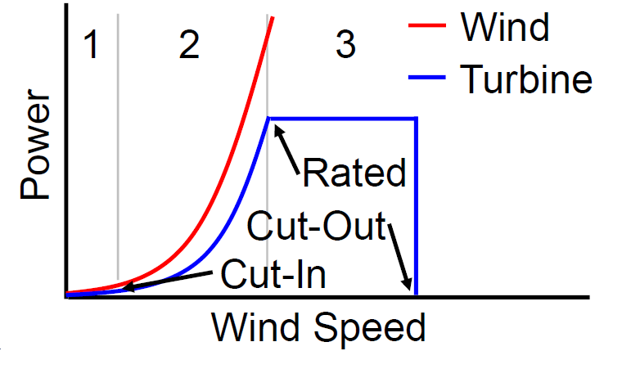
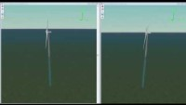
OpenFAST modules
ServoDyn
Control and Electrical Drive Dynamics
Modeling: standard conventional pitch controller
Two main operating regimes:
Maximum Power Regime
Constant Power Regime
Floating context: problems due to negative damping

Slide 18

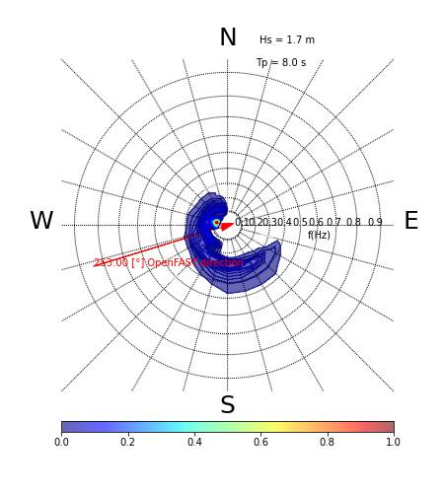
OpenFAST modules
HydroDyn
Computes wave-kinematics & hydrodynamics as part of the hydro-elastic solution
Waves & Current
Wave kinematics:
Linear regular (periodic)
Linear irregular (stochastic):
Wave direction & directional spreading
Steady sea currents:
IEC-style sub-surface, near surface, & depth-independent
Or user-defined
Hydrodynamic Loading
Strip theory (Morison)
Potential flow (WAMIT):
1st and 2nd-order (QTF or Newman’s approximation) theory
Hybrid combination of these two
Multi-Directional Sea State
IEC Sea Currents

Slide 19
OpenFAST modules
MAP++
Quasi static
Multi-segmented array of taut or catenary lines
Elastic stretching
Apparent weight of lines
Clump weights & buoyancy tanks
Seabed friction
Nonlinear geometric
MAP++ module
Constraint States:
Displacements
Velocities
Parameters:
Line properties
Line connectivity
Gravity
Inputs:
Platform displacements
Outputs:
Line tensions
Line displacements

Slide 20
Day 2 - Agenda
Introduction
Overview of OpenFAST
OpenFAST modules
Practice – Offshore wind turbine

Slide 21

Practice – Offshore wind turbine – Google Colab
What is Google Colab?
Google Colab which stands for Google Colaboratory is a cloud platform
provided by Google to run Python Notebook’s without need to install
anything on your local machine.
Features of Google Colab
Zero Setup Required
Free GPU Access
Pre-installed Libraries
Accessing Google Colab
https://github.com/Ahirvoas/Training-Day2/blob/main/Tutorial_day2.ipynb

